Slide 1
Øresund projects - Information on onshore transformer package
Marked dialog meetings during September 2020 to give initial introduction to the Øresund projects.
Project information may be changed at later stage

Slide 2
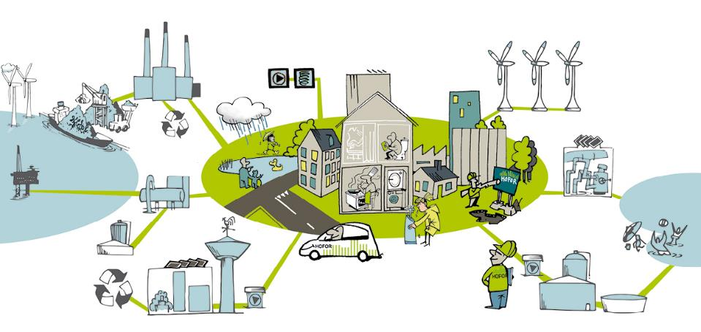
HOFOR
Amagerværket: Biomass fired power station and district heating.
Offshore wind turbines
Renewable energy
Alternative district heating methods
District cooling
Town gas
Biogas
Waterworks
Wastewater

Slide 3
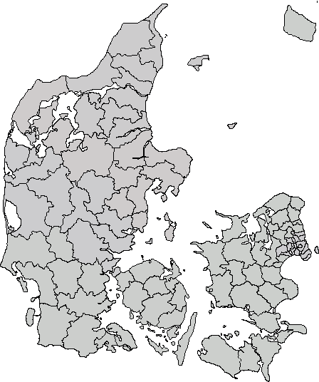
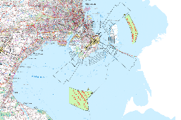
The Øresund projects will be the visible proof that Copenhagen Municipality achieves CO2 neutrality in 2025
Location
NORDRE FLINT
AFLANDSHAGE
Capacity
NORDRE FLINT (NFL):
~160 MW
...
AFLANDSHAGE (AHA):
~250 MW
“The 1st carbon neutral capital city in the world”
Copenhagen Municipality can provide loan guarantees for the full project
Timeline
Development
Construction
O&M
Start EU tender
FID
COD
Timeline
2020
2021
2022
2023
2024
2025

Slide 4
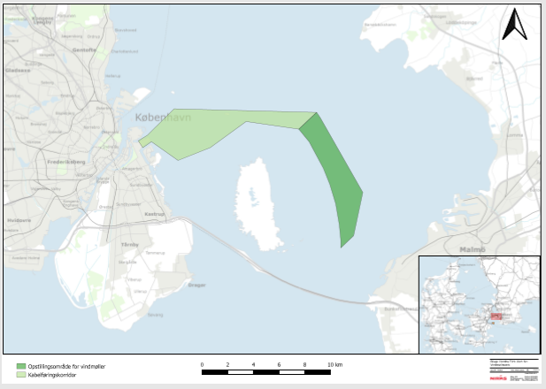
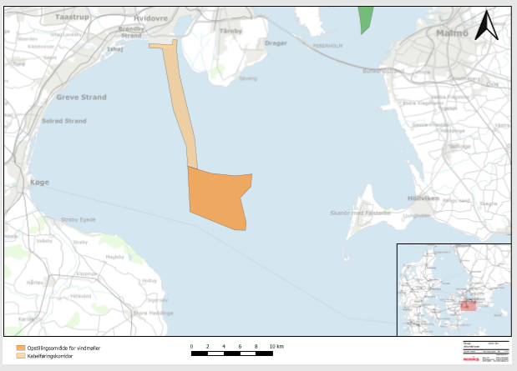
Aflandshage & Nordre Flint – project envelope
NORDRE FLINT
AFLANDSHAGE
NORDRE FLINT
...
...
Park capacity
Up to 160 MW
Up to 250 MW
WTGs
4 - 10 MW
Cable corridor
Project area
Water depths
~2,6 - 17 m
~11 - 20 m
Mean wind
@ 120m
8,2 m/s
8,9 m/s
Distance to shore
~14 km
~17 km
Tip height
Max 220
Lowest 20 m
AFLANDSHAGE
Foundations
Gravity or monopile
(interface level: 3,7 - 4,0 m)
Cable corridor
Grid connection point
At Amager Power Plant
Close to Avedøre Power Plant
Cables
(no OSS)
33 kV (~85 km)
66 kV (~55 km)
33 kV (~160 km) 66 kV (~90 km)
Project area
O&M hub
TBD / CTV

Slide 5
HOFOR‘s objective is to run a lean and efficient project
Known
technology
The project shall be built with known and reliable technology
Competency
& delivery
focused
With a lean and efficient project delivery model, HOFOR relies on competent/ expert suppliers – whom will have freedom to focus on delivering their scope
Limited
interfaces
To achieve a lean and efficient project execution, HOFOR focuses on limiting the number of interface in the project

Slide 6
In Denmark, Energinet.dk owns the grid from 132 kV - projects connect directly to the grid
HOFOR
HOFOR shall provide an area for the transformer station, construct the building, and deliver the switch gear.
HOFOR is responsible to transform from 33/66 kV to 132 kV and connect to existing grid in Energinet’s 132 kV station.
Maintenance of cables and switch gear up to the connection point is HOFOR’s responsibility (marked with red line)

Slide 7
Export cable corridor for NFL to Energinet.dk’s 132kV station at Amagerværket (power plant owned by HOFOR)
Cable corridor in blue
Connection point red dot
Cable corridor
Project area
Since Amagerværket is owned by HOFOR, the transformer station can be build on the premises
Energinet.dk is working towards establishing grid connection in 2023
2-4 cables to shore depending on number of WTGs & voltage levels
Potential cable crossings near land fall (export cable Middelgrunden Offshore Wind Farm) and in case Energinet.dk installs a 132 kV sea cable from Amager power plant to Svanemølle power plant

Slide 8
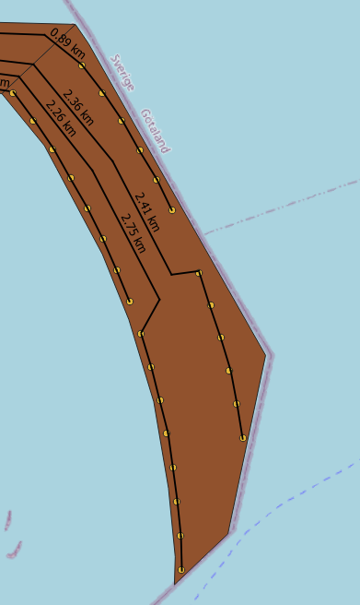
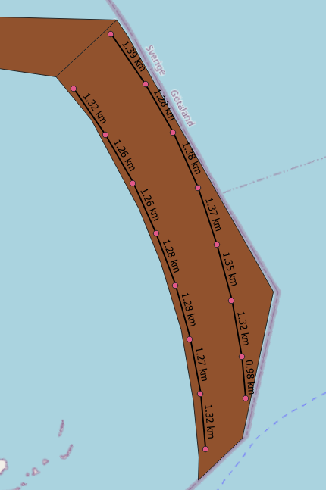
Nordre Flint – preliminary cable scenarios (no OSS)
33 kV
28 x ~5 MW WTGs
4 landfall cables
Spare cables not included
 |  | Cables length [km] | # cables
Small CSA mm2 | 300 | 12,2 | 18
Big CSA mm2 | 800 | 72,1 | 10
Total |  | 84,3 | 28
Preliminary assumption regarding burial depth is 1 to 1,5 m
Due to hard soil conditions, rock-dumping may be required for ~10% of the cables
66 kV
16 x 10 MW WTGs
2 landfall cables
Spare cables not included
 |  | Cables length [km] | # cables
Small CSA mm2 | 300 | 13,5 | 10
Big CSA mm2 | 800 | 40,7 | 6
Total |  | 54,1 | 16

Slide 9
Export cable corridor for AHA to Energinet.dk’s 132kV station near Avedøreværket (power plant)
Preliminary and indicative location of onshore substation
Cable corridor
Project area
Transformer station cannot be build on the premises of Avedøreværket
Suitable onshore area identified in the vicinity of Avedøreværket - negotiations with land owners are progressing well
Energinet.dk is working towards establishing grid connection in 2023
3-6 cables to shore depending on number of WTGs & voltage levels
Two cables crossings (TDC and Global Connect) on the way to shore
Cable corridor in green
Connection point red dot

Slide 10
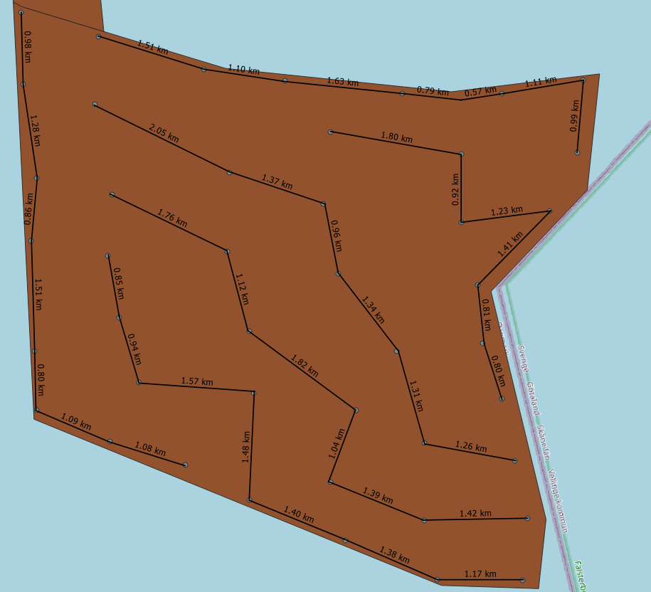
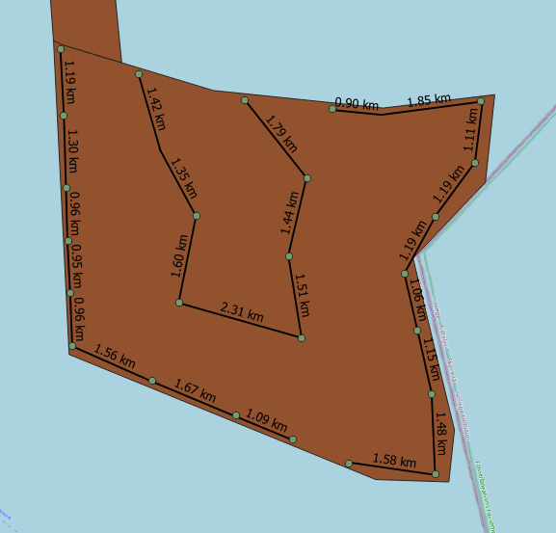
Aflandshage – preliminary cable scenarios (no OSS)
33 kV
44 x ~5 MW WTGs
6 landfall cables
Spare cables not included
 |  | Cables length [km] | # cables
Small CSA mm2 | 300 | 31,3 | 24
Big CSA mm2 | 800 | 127,3 | 20
Total |  | 158,6 | 44
Preliminary assumption regarding burial depth is 1 to 1,5 m
Due to hard soil conditions, rock-dumping may be required for ~10% of the cables
66 kV
25 x 10 MW WTGs
3 landfall cables
Spare cables not included
 |  | Cables length [km] | # cables
Small CSA mm2 | 300 | 41,2 | 15
Big CSA mm2 | 800 | 46,8 | 10
Total |  | 88,0 | 25

Slide 11
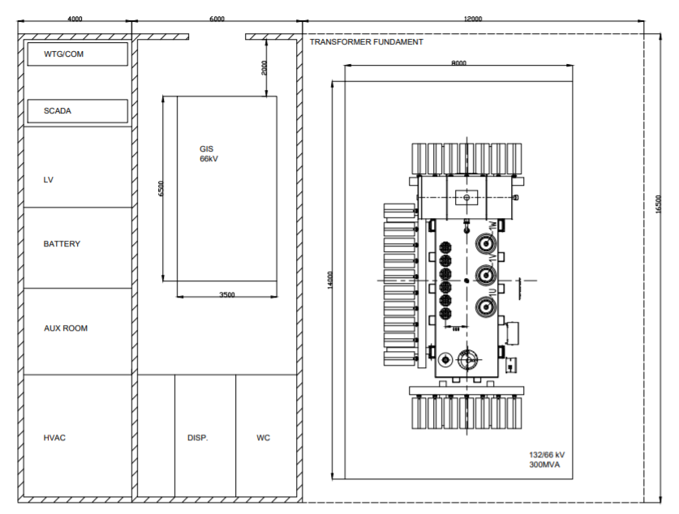
The transformer station is expected to be build on a 1000 m2 area with a size of 360 m2*

